Slide 1

Machine Learning for Engineers: Model Evaluation in Regression Models
Mina Farmanbar
Associate Professor, University of Stavanger
for engineers

Slide 2
Model Evaluation in Regression Models
The goal of regression is to build a model to accurately predict an unknown case.
To this end, we have to perform regression evaluation after building the model

Slide 3
Model Evaluation in Regression Models
we'll introduce and discuss two types of evaluation approaches that can be used to achieve this goal
we'll introduce some metrics for accuracy of regression models

Slide 4
Model Evaluation Approaches
When considering evaluation models, we clearly want to choose the one that will give us the most accurate results.
So, the question is:
How can we calculate the accuracy of our model?
In other words, how much can we trust this model for prediction of an unknown sample using a given dataset and having built a model such as linear regression?
One of the solutions is to select a portion of our dataset for testing.

Slide 5
Model Evaluation Approaches
Train and Test on the same Dataset
Train/Test Split
K-fold cross-validation
Dataset
Training Data
Testing Data

Slide 6
Model Evaluation Approaches
Train and Test on the same Dataset

Slide 7
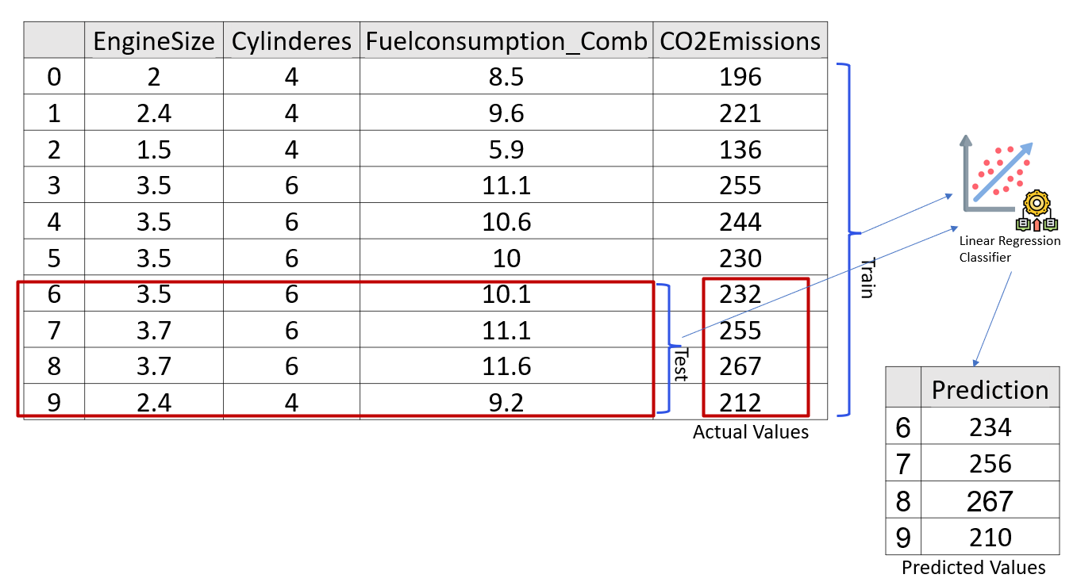
Train and Test on the same Dataset

Slide 8
Train and Test on the same Dataset
There are different metrics to report the accuracy of the model, but most of them work generally based on the similarity of the predicted and actual values.

Slide 9
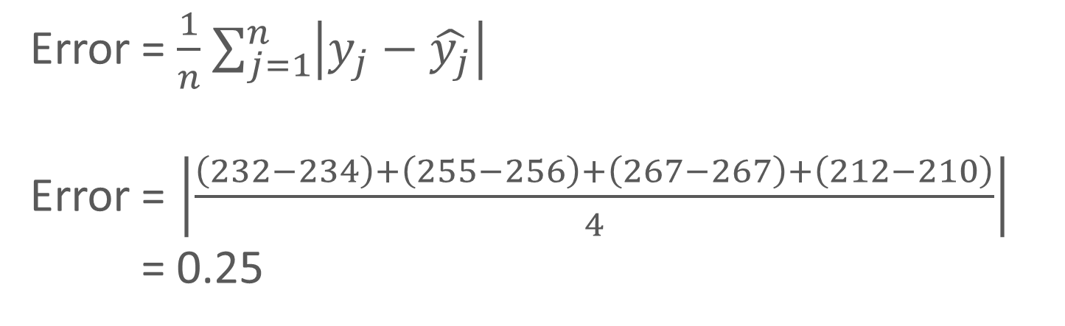
Train and Test on the same Dataset
Error = $\frac{1}{n}$ $\sum_{j=1}^{n}{\left|y_{j}−\hat{y_{j}}\right|}$
Error = $\left|\frac{\left(232−234\right)+\left(255−256\right)+\left(267−267\right)+\left(212−210\right)}{4}\right|$
= 0.25

Slide 10
Train and Test on the same dataset

Slide 11
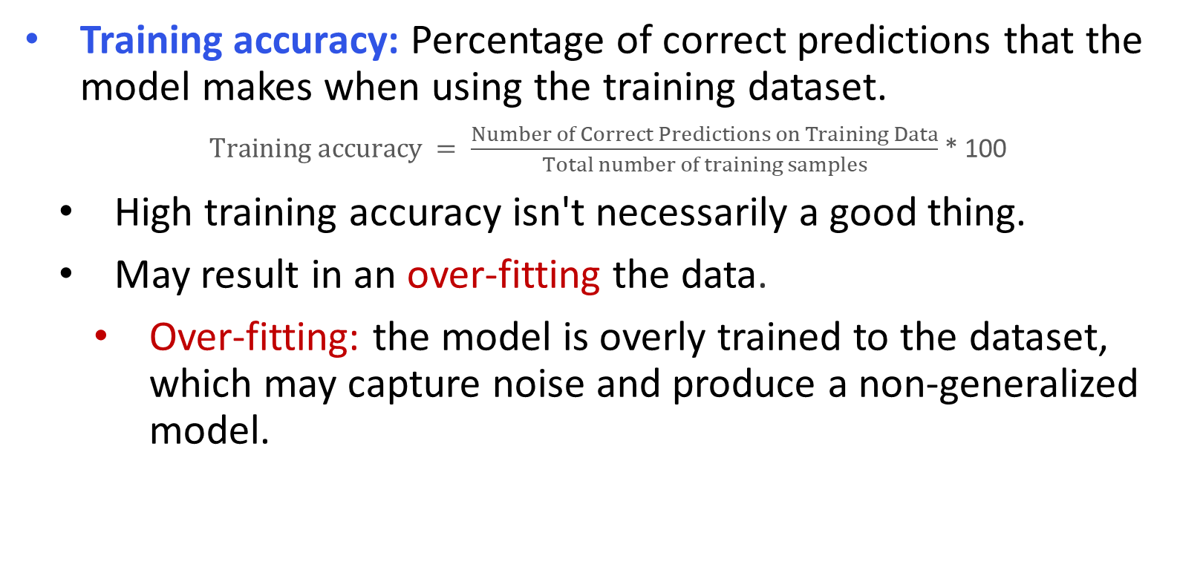
Training and Testing accuracy
Training accuracy: Percentage of correct predictions that the model makes when using the training dataset.
$Training accuracy = \frac{Number of Correct Predictions on Training Data}{Total number of training samples}$ * 100
High training accuracy isn't necessarily a good thing.
May result in an over-fitting the data.
Over-fitting: the model is overly trained to the dataset, which may capture noise and produce a non-generalized model.

Slide 12
Training and Testing accuracy
Testing accuracy: percentage of correct predictions that the model makes on data that the model has not been trained on.
It's important that our models have high testing accuracy
How can we improve the Testing accuracy??

Slide 13
Train and Test split
Train/Test Split

Slide 14
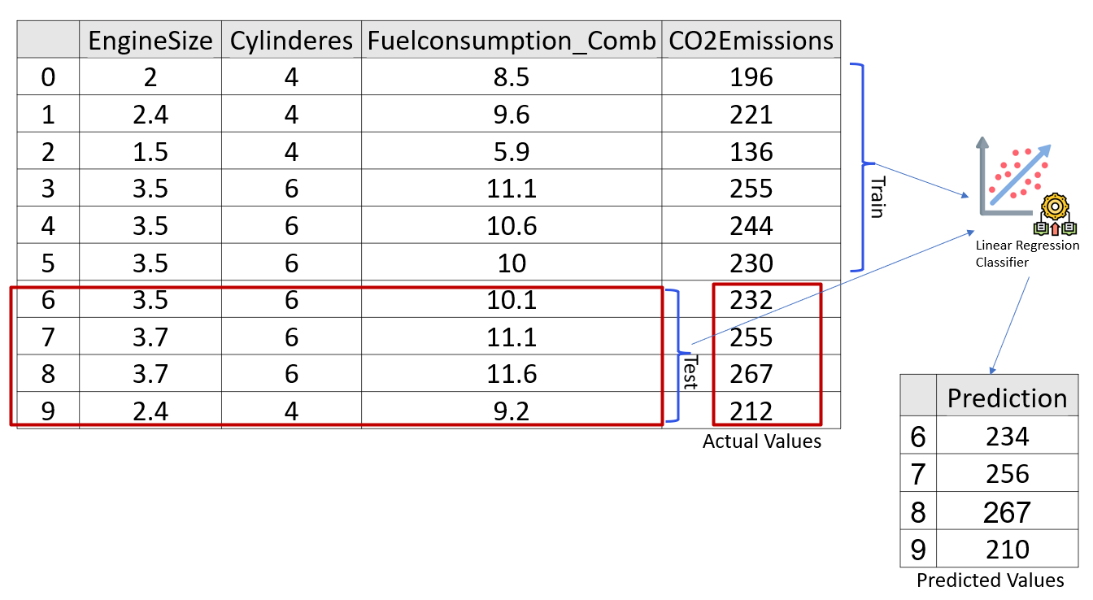
Train and Test split

Slide 15
Problems…
Train and Test split
The issue with train/test split is that it's highly dependent on the datasets on which the data was trained and tested.
The variation of this causes train/test split to have a better testing prediction than training and testing on the same dataset, but it still has some problems due to this dependency.

Slide 16
K-fold cross-validation
K-fold cross-validation

Slide 17
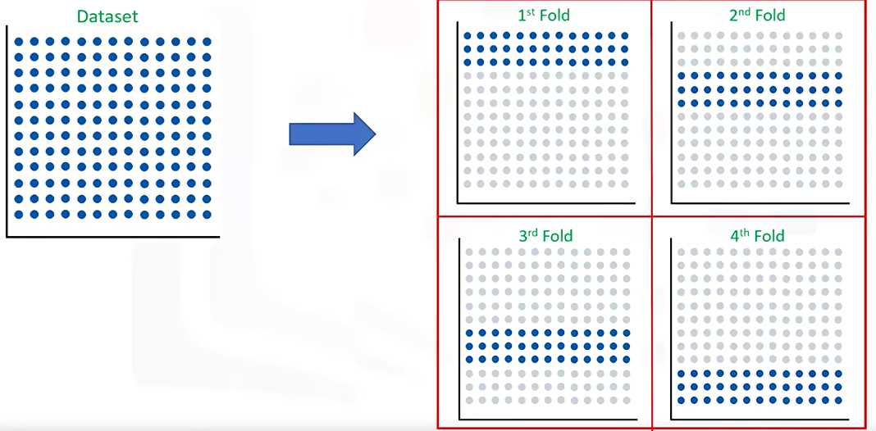
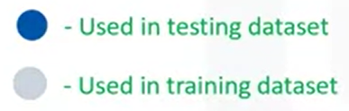
K-fold cross-validation
https://miro.medium.com/v2/resize:fit:720/format:webp/1*7D-u0g9Qw88IqO_14qTb0A.png
Accuracy = avg (80% + 84% + 82% + 86%) = 83%

Slide 18
Summary
We have discussed different evaluation approaches with each pros and cons.
Train and test on the same dataset:
Pros: Simple to implement.
Cons: Overfitting
Train-Test Split:
Pros: Simple and fast to implement.
Cons: The evaluation may be sensitive to how the data is split, potentially leading to biased or unreliable performance estimates.

Slide 19
Summary
Cross-Validation (e.g., k-Fold Cross-Validation):
Pros: Provides a more reliable estimate of model performance by averaging results across multiple splits.
Cons: More computationally intensive than a simple train-test split. Requires running the model multiple times.

Slide 20
Thank you
Mina Farmanbar
mina.farmanbar@uis.no

